Slide 1
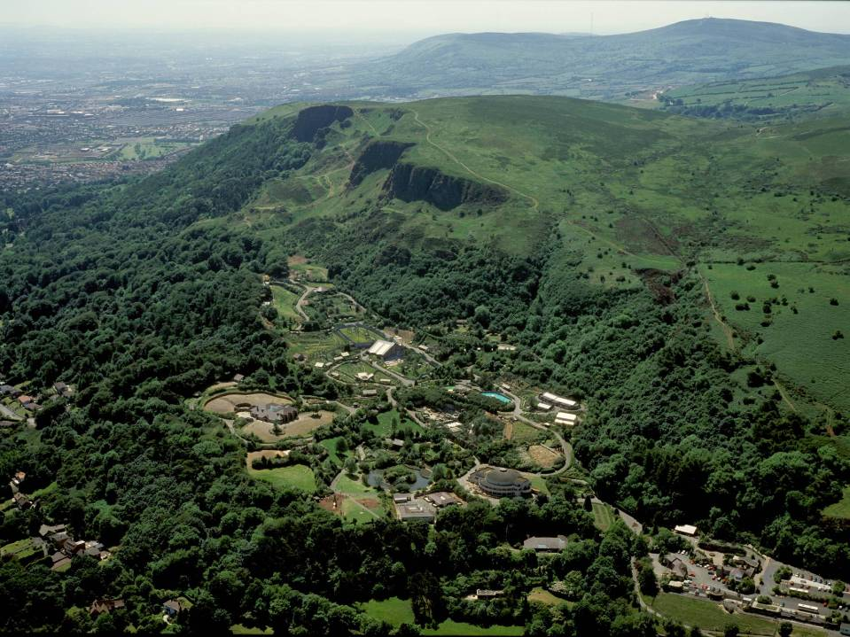
Outdoor Recreation on the Fringes
CRN Talk
Lisburn Island Centre
10/5/13
Dr. Jim Bradley
Partnership Manager

Slide 2
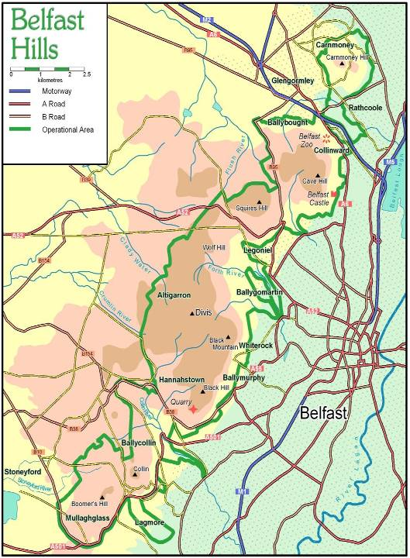
4400 hectares
4 Council areas
Mostly privately owned
Carnmoney Hill
Cave Hill Country Park
Divis
Colin Glen
Slievenacloy ASSI
Notes:
Newtownabbey is to the northern end of what is the line of summits of the Belfast or South Antrim Hills
Plus ‘fingers’ into urban areas
Very rare mix of urban/rural fringes and uplands with their own issues – access, waste, quarrying

Slide 3
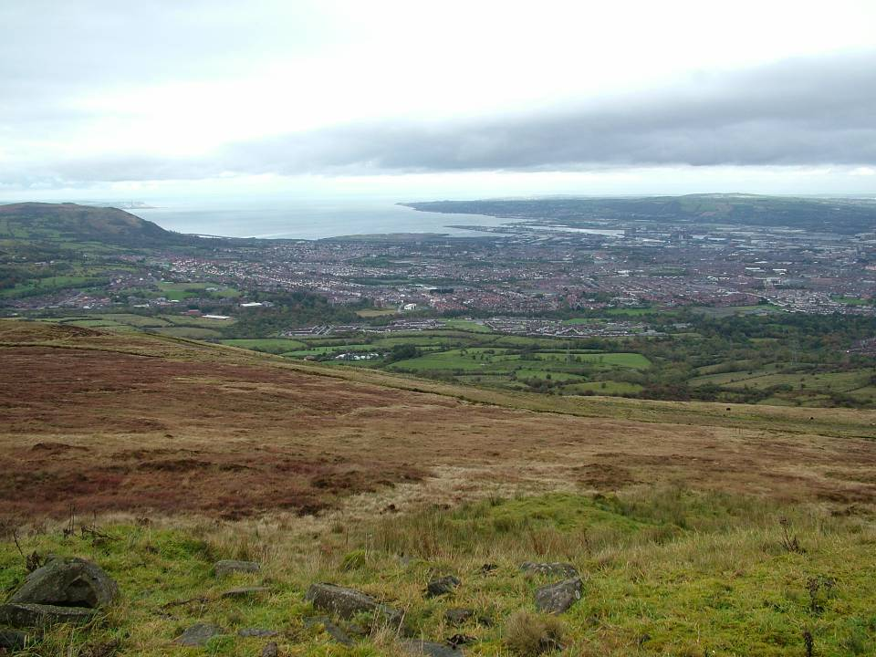
BELFAST HILLS PARTNERSHIP
PARTNERSHIP with three staff AUG 2004
COMMUNITY GROUPS
COMMUNITY ENVIRONMENTAL GROUPS
FARMERS
QUARRY OWNERS
COMMERCIAL OPERATORS - WASTE MANAGEMENT
STATUTORY – NIEA & 4 COUNCILS - MAIN FUNDERS
ENVIRONMENTAL ORGANISATIONS
RECREATION
Notes:
Impressive range of interests which therefore includes issues between partners

Slide 4
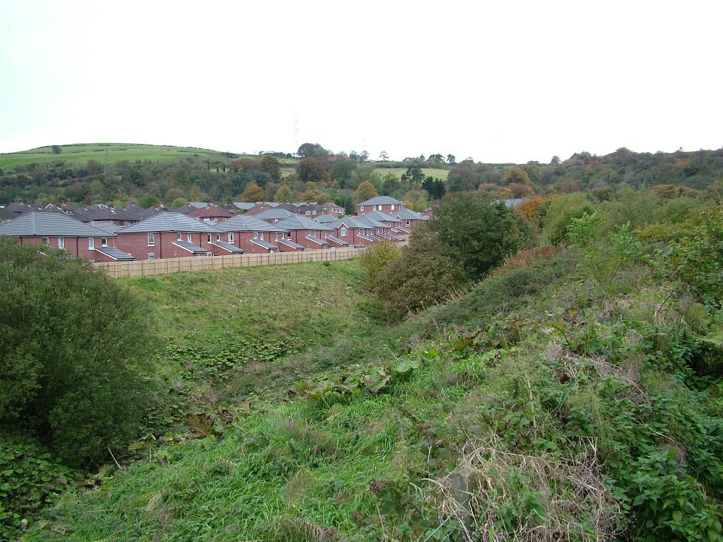
BELFAST HILLS PARTNERSHIP AIMS
To care for the hills, their wildlife and people
Conserve, protect and enhance the natural, cultural and built heritage of the Belfast Hills
Encourage individuals, communities and organisations to care for the Belfast Hills
Raise awareness of the value of the Belfast Hills and of issues relating to their protection
Manage existing recreational use of the Belfast Hills
Support and assist farmers and landowners under pressure from urban development and from inappropriate forms of countryside recreation
Contribute to the economic regeneration of communities in the Belfast Hills and adjoining areas
Contribute to a positive image of the Hills and its hinterlands be being an attractive, well managed and functioning part of the area.

Slide 5
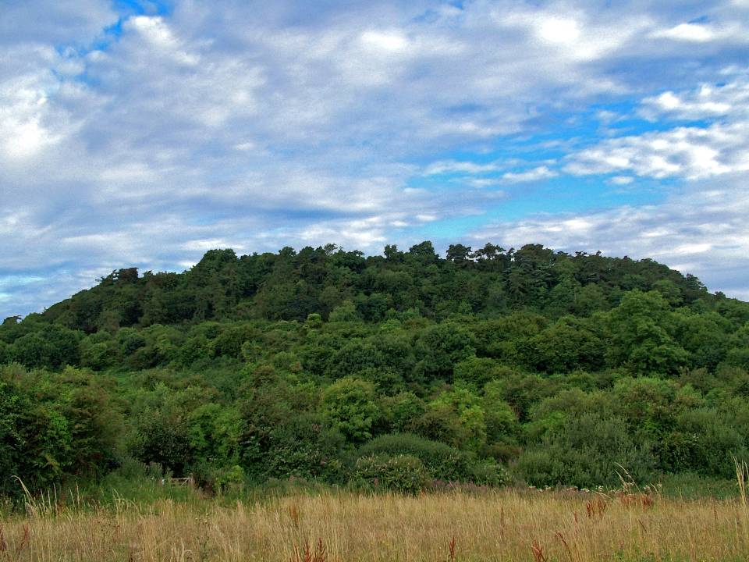
Historic Outdoor Recreation
18th – 20th C - Deer Parks, Shooting
Town Fairs at Cave Hill - access issues
Walking – from the “Big Houses”

Slide 6
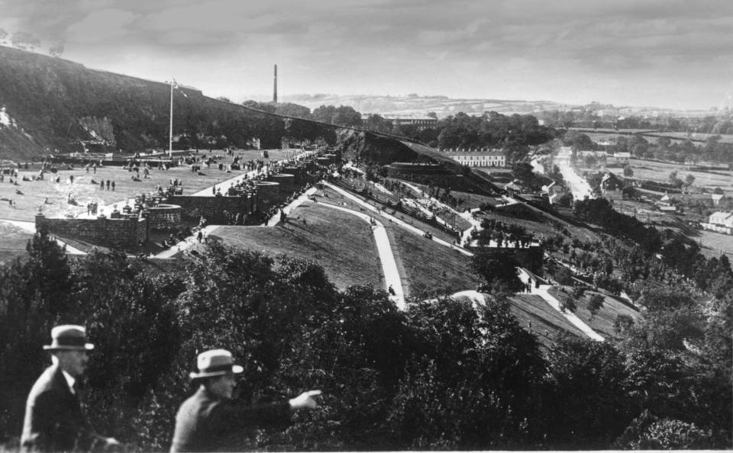
Tram Company developments

Slide 7
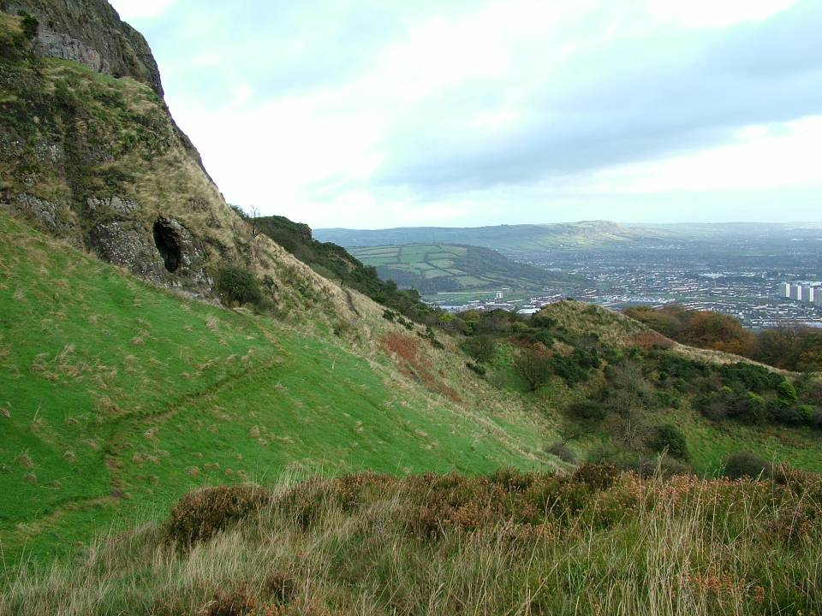
More recent recreation
Walking & country parks
Mountain biking
Geocaching
Road cycling
So what’s so unique??

Slide 8
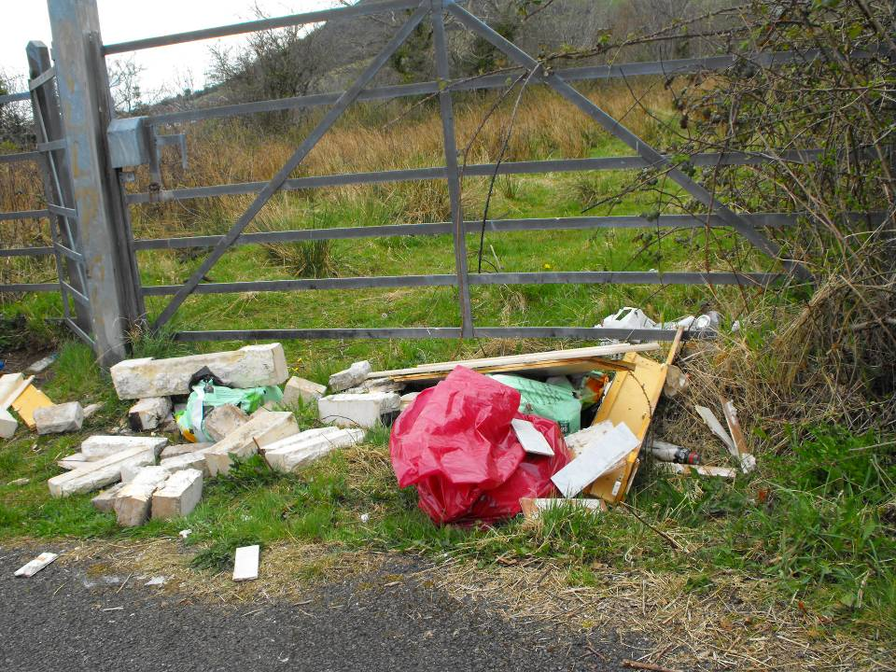
Typical urban fringe issues
Flytipping/illegal waste
Dereliction/abandonment - speculation
Unwanted facilities out of sight e.g. electricity stations, waste / industrial facilities, traveller sites
Farming in the fringes

Slide 9
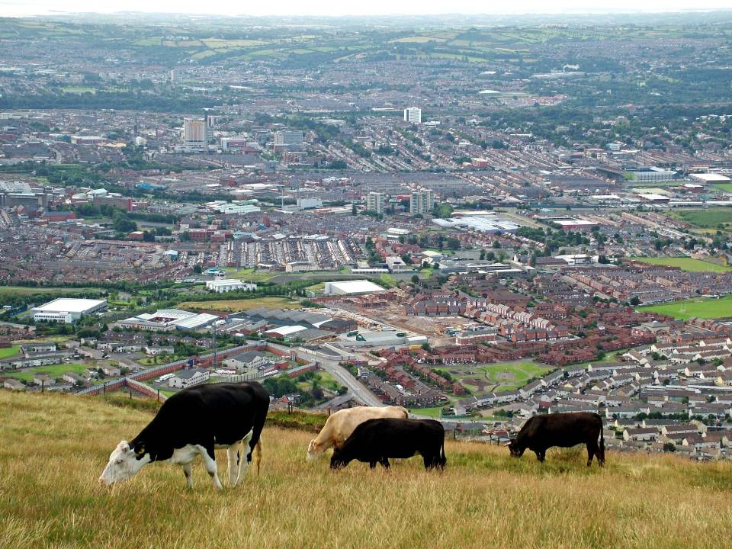

Slide 10
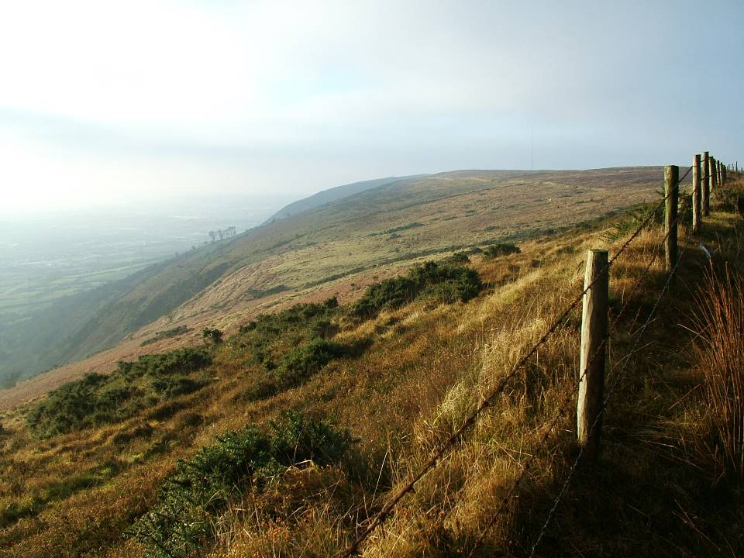
Fringe Uplands
Steep slopes
Quarries – clay pigeon shooting
Old lanes and paths up to abandoned upland houses/settlements
Lots of small spate rivers flowing into city –mills, mill dams and mill villages
Village neighbourhood mentality?

Slide 11
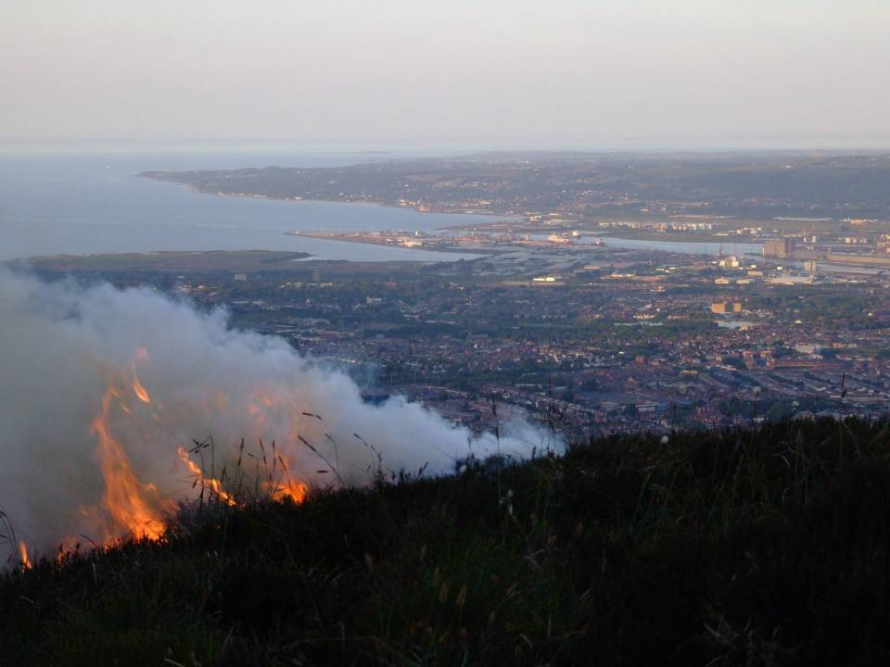
plus Wildfires!

Slide 12
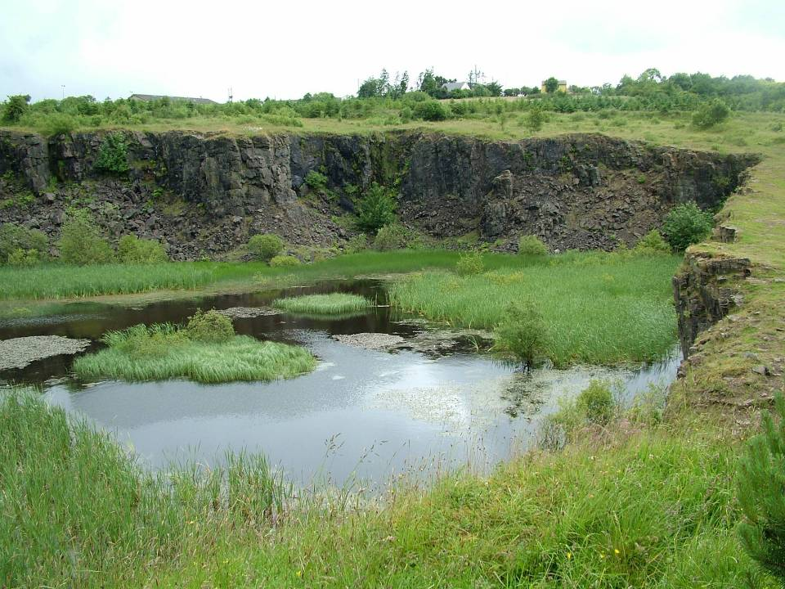

Slide 13
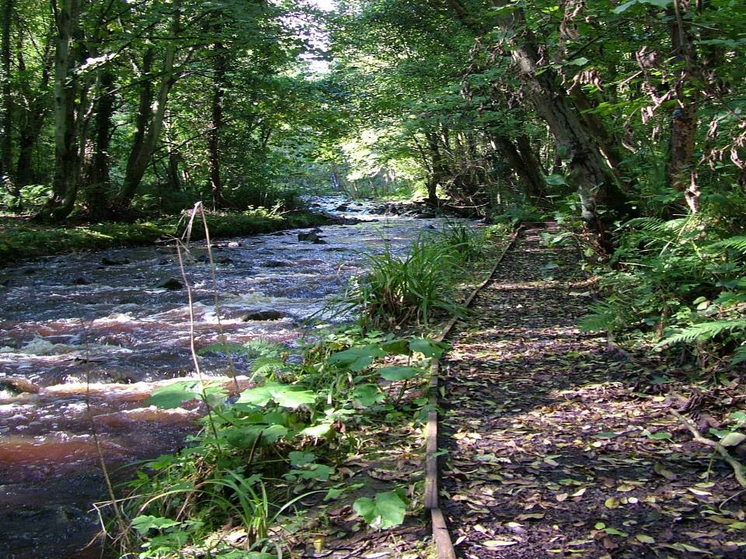
Urban Rivers
Often boundaries between communities
Great potential for recreation and environmental education / community action

Slide 14
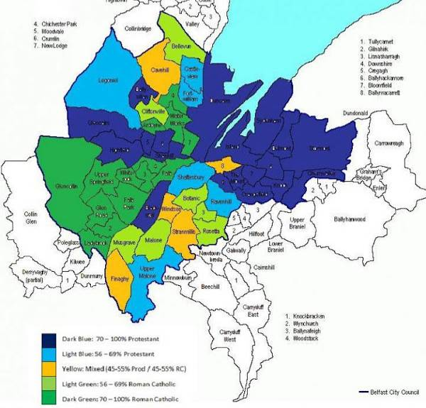
Sectarian demography of Belfast
Very high levels of deprivation in isolated wards

Slide 15
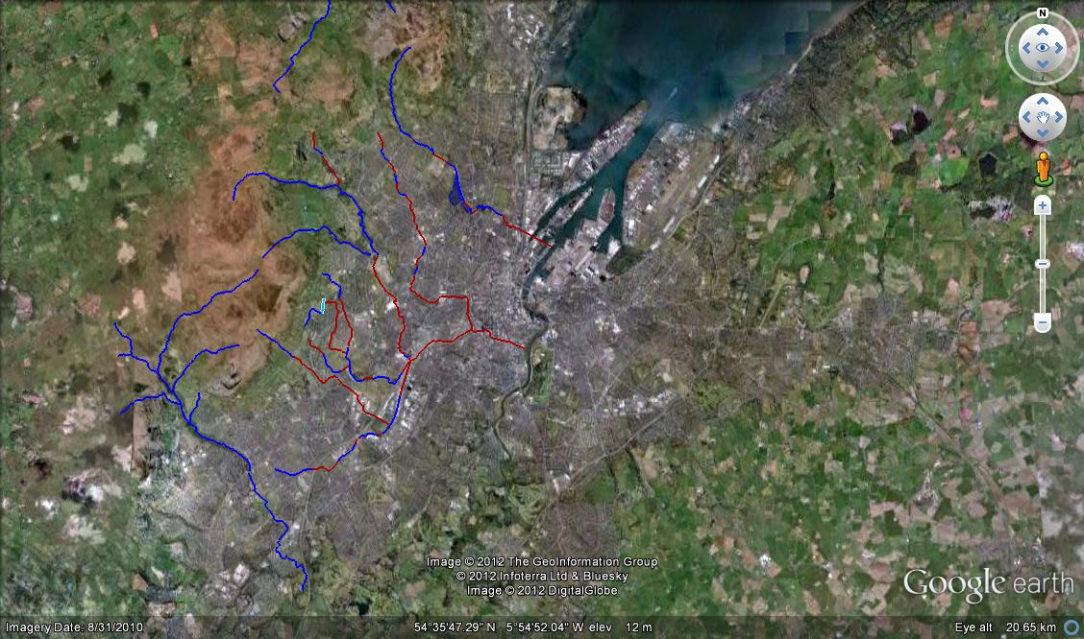

Slide 17
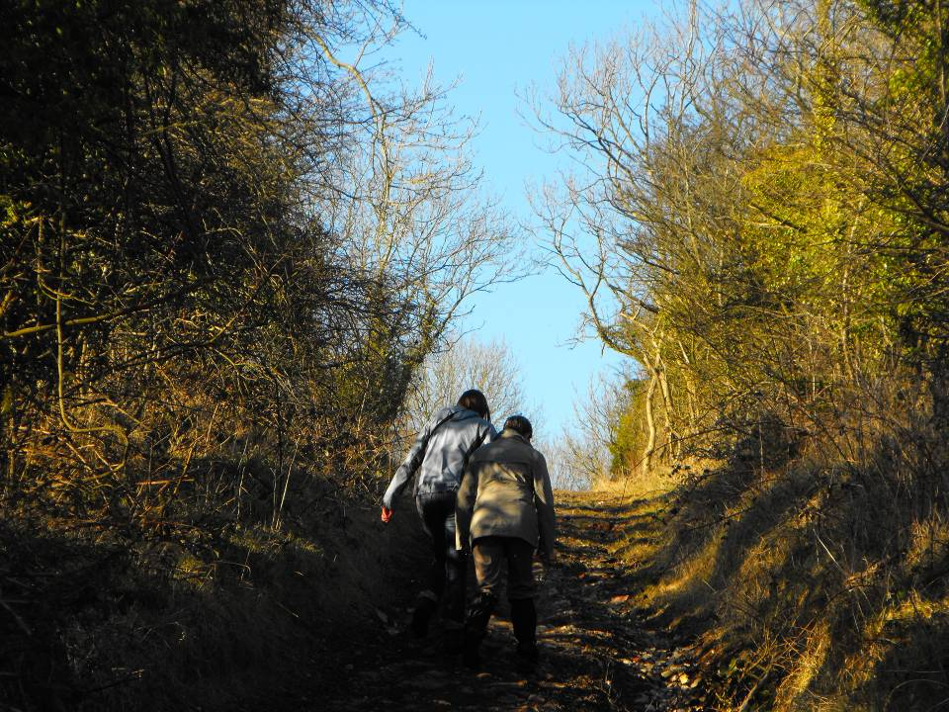

Slide 18
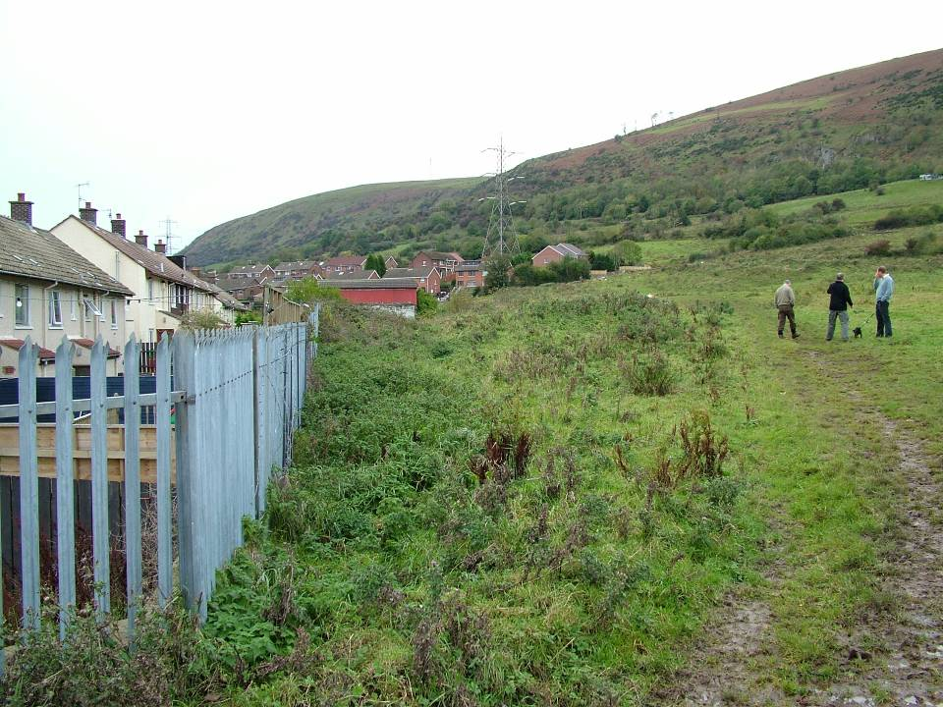
Ballymurphy/Highfield

Slide 19
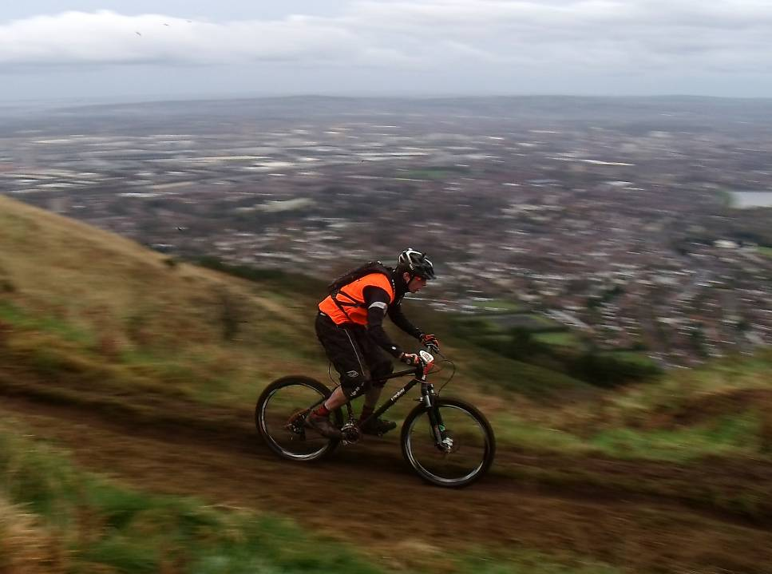
Challenges
Patiently build up relationships and fully joint projects
Make new connections, both physically and mentally
Get communities to think beyond their local needs?......
by addressing major health issues for deprived areas

Slide 20
Thank you! Any questions?

